Slide 1
Image Caption Generation using Deep Reinforcement Learning based on Cloud
Team Details
P. Harshavardhan Reddy (20EG105238)
M. Soumith (20EG105235)
K. Shashidhar Reddy (20EG105228)
Project Supervisor
Mr. G. Kiran Kumar
Assistant Professor

Slide 2
Introduction
Whenever an image appears in front of us, our brain can annotate or label it. But what about computers? How can a machine process and label an image with a highly relevant and accurate caption? It seemed quite impossible a few years back.
Still, with the enhancement of Computer Vision and Deep learning algorithms, the availability of relevant datasets, and AI models, it becomes easier to build a relevant caption generator for an image.
Image captioning is a challenging problem owing to the complexity in understanding the image content and diverse ways of describing it in natural language.
Recent advances in deep neural networks have substantially improved the performance of this task.
Image caption generator is a process of recognizing the context of an image and annotating it with relevant captions using deep learning and computer vision.

Slide 3
Introduction
It includes labelling an image with English keywords with the help of datasets provided during model training.
Most state-of-the-art approaches follow an encoder-decoder framework, which generates captions using prediction models. Some famous models include CNN-LSTM, Attention Mechanisms, Xception models.
However, in this paper, we introduce a novel decision-making framework for image captioning. We utilize a "policy network" and a "value network" to collaboratively generate captions.
The policy network serves as a local guidance by providing the confidence of predicting the next word according to the current state.
Some famous datasets include Flickr_8k, Flickr_30k, Coco dataset which has images along with captions.

Slide 4
Literature
Author(s) | Method | Advantages | Disadvantages
1 Neha Kumar, 2 Rishabh Anand, 3 Samay M Shetty, 4 Shikhar Jaiswal | Image Caption Generator Using CNN and LSTM | More Reliable More Efficient | Complex Implementation. Less Accuracy
1 Vaishnavi Agrawal; 2 Shariva Dhekane | Image Caption Generation Using Attention Mechanism. | Generates next word based on individual features. | More expensive Architecture.

Slide 5
Problem Statement
The problem statement revolves around the need for image caption generation. For example - Object detection in satellite imagery is a challenging task due to the small object size relative to the image size. Traditional approaches such as one-shot object detection and region based proposal methods struggle to achieve high detection accuracy and require significant computational resources. Using Models such as CNN and RNN are not efficient considering the accuracy and the detail to be captured.
Objective
This Project proposes a novel approach to generate captions from objects or images using deep reinforcement learning. Our proposed solution utilizes the features of traditional models combined with deep reinforcement learning to achieve better results by achieving higher accuracy.

Slide 6
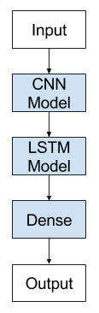
Existing Method
CNN-LSTM model, specifically designed for sequence prediction problems with spatial inputs, like images or videos. This architecture involves using Convolutional Neural Network (CNN) layers for feature extraction on input data combined with LSTMs to perform sequence prediction on the feature vectors.
In short, CNN LSTMs are a class of models that are both spatially and temporally deep and sit at the boundary of Computer Vision and Natural Language Processing. These models have enormous potential and are being increasingly used for many sophisticated tasks such as text classification, video conversion, and so on.
Models for captioning involve two main elements:
Feature Extraction.
Language Model.

Slide 7
Proposed Method
In this paper, we introduce a novel decision-making framework for image captioning. Instead of learning a sequential model to greedily look for the next correct word, we utilize a “policy network” and a “value network” to jointly determine the next best word at each time step.
The policy network, which provides the confidence of predicting the next word according to current state, serves as a local guidance. The value network, that evaluates the reward value of all possible extensions of the current state, serves as a global and lookahead guidance.
Such value network adjusts the goal of predicting the correct words towards the goal of generating captions that are similar to ground truth captions. Our framework is able to include the good words that are with low probability to be drawn by using the policy network alone.

Slide 8
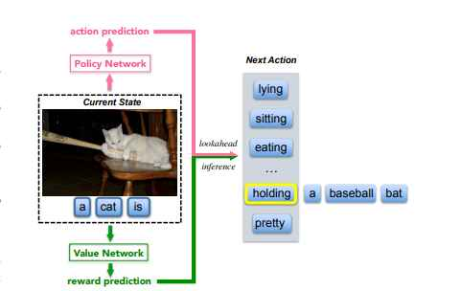
Proposed Method
Illustration of the proposed decision-making framework. During our lookahead inference procedure, we utilize a “policy network” and a “value network” to collaboratively predict the word for each time step. The policy network provides an action prediction that locally predicts the next word according to current state. The value network provides a reward prediction that globally evaluates all possible extensions of the current state.

Slide 9
Project status
S.No | Functionality | Status (Completed /in-progress/Not started)
1) | Installation of software | Completed
2) | Extracting Features from Image | Completed
3) | Build CNN-RNN Model | Completed
4) | Generation of Captions by using deep reinforcement learning | Not Started

Slide 10
References
X. Chen and C.L. Zitnick, "Mind's eye: A recurrent visual representation for image caption generation", CVPR, 2015.
Image Caption Generator Using CNN and LSTM 1 Neha Kumar, 2 Rishabh Anand, 3 Samay M Shetty, 4 Shikhar Jaiswal 1,2,3,4 Student Information Science and Engineering RVITM, Bangalore, India TIJER || ISSN 2349-9249 || © July 2023 Volume 10, Issue 7 || www.tijer.org
S. Xie, R. Girshick, P. Dollár, Z. Tu, K. He. Deep Reinforcement Learning-based Image Captioning with Embedding Reward. Computer Vision and Pattern Recognition, 2017. CVPR 2017.

Slide 11
THANK YOU

